Slide 1
Database Design &
Implementation
for a Fitness Center
Database Design & Implementation — Group Project
Week 13 Presentation
Presented by: Marcus Podnar and Nickolas Gabrialovitch

Slide 2
Table of Contents
01
Project Overview
Objective and scope of the fitness center database
05
MongoDB Collections
NoSQL implementation for Locations and Coaches
02
Conceptual Model (EER Diagram)
Entities, attributes, and relationships
06
SQL SELECT Statements
Queries mapped to wireframe screens
03
Relational Model
Logical data model and normalization to 3NF
07
Closing
Project wrap-up
04
SQL: Create & Insert
Table creation scripts and sample data

Slide 3
Project Overview
OVERVIEW
Objective
Expand on the database design concepts we learned in class by building a full database system for a fitness center.
14
4
Deliverables We Completed
Tables
Wireframes
Conceptual EER Diagram
Relational Data Structure Diagram (3NF)
SQL: CREATE TABLE scripts
SQL: INSERT sample data
MongoDB Collections (Locations & Coaches)
SQL SELECT statements (4 wireframes)
2
3NF
NoSQL
Normal Form

Slide 4
Project Overview
OVERVIEW
Database Design & Implementation for a Fitness Center
What We Built
EER diagram: 6 strong entities, 2 weak entities, resolved with association tables
Relational model: 14 tables, all normalized to 3NF
SQL: CREATE TABLE with FK constraints, one INSERT per table to validate schema
MongoDB: Locations and Coaches as embedded documents with arrays
SELECT queries mapped to 4 wireframe app screens
Problem Context
A multi-location fitness center needs a system to track members, coaches, classes, locations, amenities, and certifications. Entities share complex many-to-many relationships requiring careful modeling to avoid redundancy and support real queries.
Entities Modeled
Member, Coach, Location, Class
Amenity, Certificate
Weak entities: Review, Reference
Tools and Technologies
Draw.io for EER and relational diagrams
SQLite for CREATE, INSERT, and SELECT statements
MongoDB for NoSQL document collections
Approach
Started from business rules, built the EER diagram, converted to relational, enforced 3NF across all tables, then implemented SQL and a MongoDB layer for flexible document storage.

Slide 5
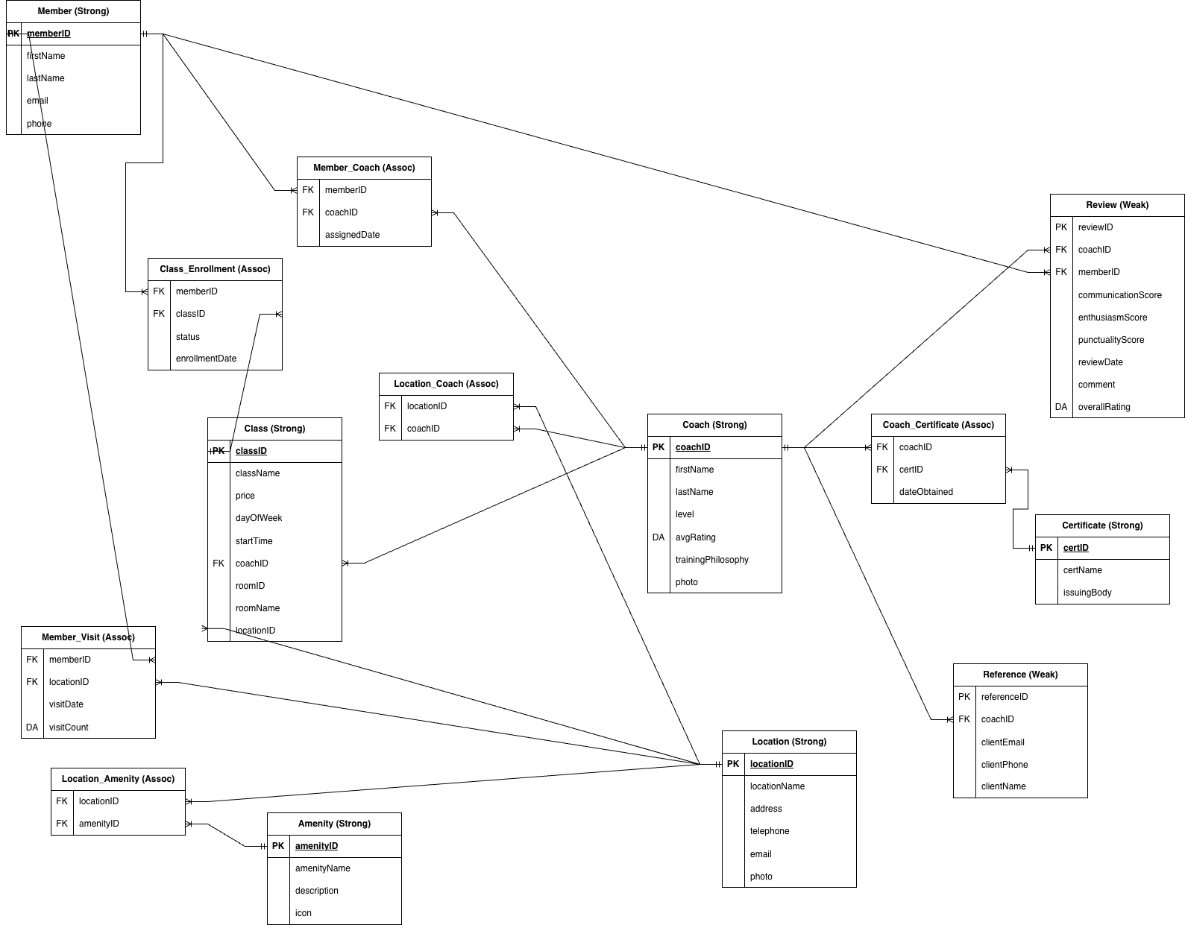
Conceptual EER Diagram
CONCEPTUAL MODEL
Deliverable 1 — designed using Draw.io
Strong entities: Member, Coach, Location, Class, Amenity, Certificate | Weak entities: Review, Reference | Association tables resolve many-to-many relationships

Slide 6
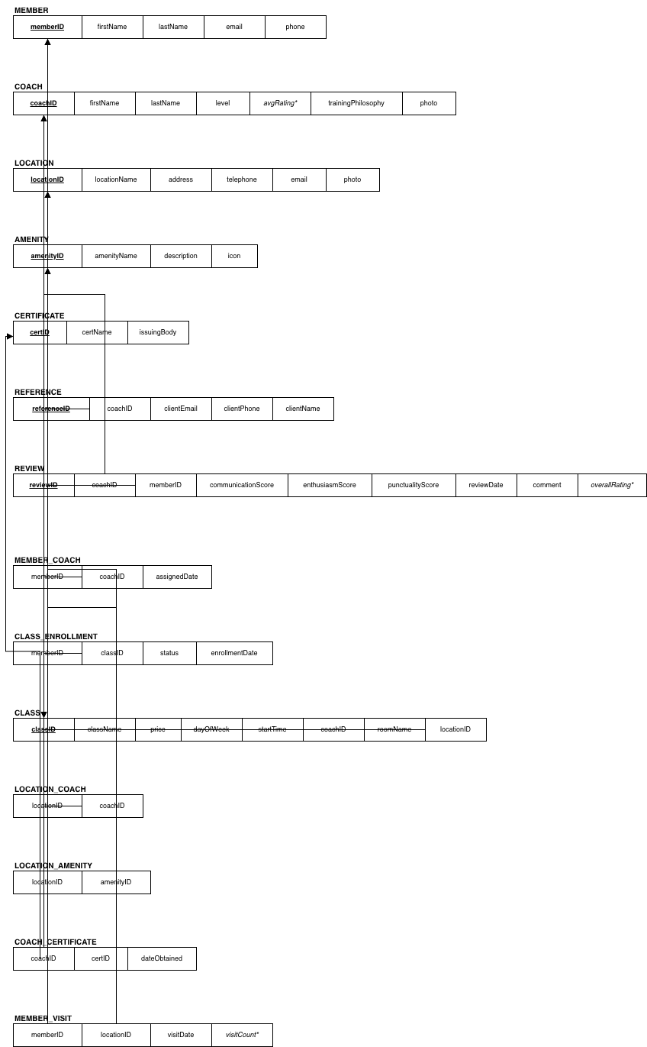
Relational Model (3NF)
RELATIONAL MODEL
Deliverable 2 — ER to Relational conversion
Third Normal Form (3NF)
1NF: All attributes are atomic, no repeating groups.
2NF: Every non-key attribute depends on the full primary key.
3NF: No transitive dependencies — attributes depend only on the PK.
Association tables (Member_Coach, Location_Amenity, etc.) use composite PKs to resolve many-to-many relationships.
avgRating and overallRating are derived attributes, kept for query performance.
14 Tables Total
Member, Coach, Location, Amenity, Certificate, Class, Review, Reference_, Member_Coach, Class_Enrollment, Coach_Certificate, Location_Coach, Location_Amenity, Member_Visit

Slide 7
SQL: CREATE TABLE Scripts
SQL IMPLEMENTATION
Deliverable 3 — enforcing constraints and relationships
CREATE TABLE Member (
memberID INTEGER PRIMARY KEY,
firstName TEXT NOT NULL,
lastName TEXT NOT NULL,
email TEXT NOT NULL UNIQUE,
phone TEXT
);
CREATE TABLE Coach (
coachID INTEGER PRIMARY KEY,
firstName TEXT NOT NULL,
lastName TEXT NOT NULL,
level TEXT,
avgRating REAL,
trainingPhilosophy TEXT,
photo TEXT
);
CREATE TABLE Location (
locationID INTEGER PRIMARY KEY,
locationName TEXT NOT NULL,
address TEXT NOT NULL,
telephone TEXT,
email TEXT,
photo TEXT
);
CREATE TABLE Location_Coach (
locationID INTEGER NOT NULL,
coachID INTEGER NOT NULL,
PRIMARY KEY (locationID, coachID),
FOREIGN KEY (locationID)
REFERENCES Location(locationID),
FOREIGN KEY (coachID)
REFERENCES Coach(coachID)
);
All 14 tables follow the same pattern. Foreign key constraints enforce referential integrity. Association tables use composite primary keys.

Slide 8
SQL: INSERT Sample Data
SQL IMPLEMENTATION
Deliverable 4 — one row per table to validate structure
-- Sample Member
INSERT INTO Member (memberID, firstName, lastName, email, phone)
VALUES (1, 'Alex', 'Johnson', 'alex.j@email.com', '647-555-0101');
-- Sample Coach
INSERT INTO Coach (coachID, firstName, lastName, level, avgRating, trainingPhilosophy)
VALUES (1, 'Jordan', 'Park', 'Senior', 4.8, 'Strength-first progressive overload');
-- Sample Location
INSERT INTO Location (locationID, locationName, address, telephone, email)
VALUES (1, 'Downtown Hub', '123 King St W, Toronto, ON', '416-555-1001', 'downtown@gym.com');
-- Sample Class
INSERT INTO Class (classID, className, price, dayOfWeek, startTime, coachID, locationID)
VALUES (1, 'Morning HIIT', 20.00, 'Monday', '07:00', 1, 1);
-- Link Member to Coach
INSERT INTO Member_Coach (memberID, coachID, assignedDate)
VALUES (1, 1, '2024-01-15');
One INSERT row was added to every table to confirm schema validity and test foreign key constraints.

Slide 9
MongoDB Collections
NOSQL
Deliverable 5 — Locations and Coaches as NoSQL documents
use("fitness_center");
db.createCollection("locations");
db.locations.insertOne({
locationID: 1,
locationName: "Downtown Hub",
address: "123 King St W, Toronto, ON",
telephone: "416-555-1001",
amenities: ["Swimming Pool", "Sauna", "Spin Studio"]
});
db.createCollection("coaches");
db.coaches.insertOne({
coachID: 1,
firstName: "Jordan", lastName: "Park",
level: "Senior", avgRating: 4.8,
locations: ["Downtown Hub"],
certificates: [{ certID: 1, dateObtained: "2018-06-15" }],
references: [{ clientName: "Marcus Reid",
clientEmail: "mreid@corp.com" }]
});
Why MongoDB?
Amenities and certificates are variable-length arrays, ideal for document storage.
Avoids extra junction tables required in relational SQL.
Locations and Coaches are self-contained documents, making reads faster.
Demonstrates polyglot persistence: SQL for structured data, MongoDB for flexible embedded data.

Slide 10
SQL SELECT Statements
SELECT QUERIES
Deliverable 6 — queries mapped to 4 wireframe screens
Wireframe 1
Wireframe 2
Locations Tab
Midtown Location Tab
SELECT l.locationName,
SUM(mv.visitCount) AS timesVisited
FROM Member_Visit mv
JOIN Location l
ON l.locationID = mv.locationID
WHERE mv.memberID = 1
AND strftime('%Y-%m', mv.visitDate)
= strftime('%Y-%m', 'now')
GROUP BY l.locationID;
SELECT locationName, address,
telephone, email
FROM Location
WHERE locationName = 'Midtown Studio';
SELECT a.amenityName FROM Amenity a
JOIN Location_Amenity la
ON la.amenityID = a.amenityID
JOIN Location l
ON l.locationID = la.locationID
WHERE l.locationName = 'Midtown Studio';
Wireframe 3
Wireframe 4
Coaches Tab
Coach Profile Tab
-- My Coaches
SELECT c.firstName, c.lastName,
c.level, c.avgRating
FROM Coach c
JOIN Member_Coach mc
ON mc.coachID = c.coachID
WHERE mc.memberID = 1;
-- All Coaches
SELECT firstName, lastName,
level, avgRating FROM Coach;
SELECT firstName, lastName, level,
avgRating, trainingPhilosophy
FROM Coach WHERE coachID = 1;
SELECT cert.certName
FROM Certificate cert
JOIN Coach_Certificate cc
ON cc.certID = cert.certID
WHERE cc.coachID = 1;

Slide 11
Week 13 Presentation
Database Design & Implementation
for a Fitness Center
Marcus Podnar and Nickolas Gabrialovitch
Thank You

